Slide 1
CS4710: Artificial Intelligence Search
Many AI problems boil down to graph search. What are the primary techniques for searching graphs? What do we do when the graph is very large?

Slide 2
Game Playing Systems

Slide 3
Games!
Games are well-defined problems that are generally interpreted as requiring intelligence to play well.
There is definitely some uncertainty in games because you don’t know what your opponent will do.
Usually only interesting when search spaces are VERY large (no surprise there).

Slide 4
Humans are pretty good at games
Human players do quite well at games, but it probably is not because humans are good at exhaustively searching the possible outcomes in a game.
We are good at ignoring irrelevant paths in the “game tree” and remembering patterns we’ve seen before.
Thus, this is a good test domain for search and for AI

Slide 5
Game Playing AIs
Main idea: Represent the game as a search tree
If the search tree is small, we can search every possible way the game can play out and the AI can always play optimally!
If not, we need some heuristics that help the AI focus its search on more promising areas.
Let’s take a look!

Slide 6
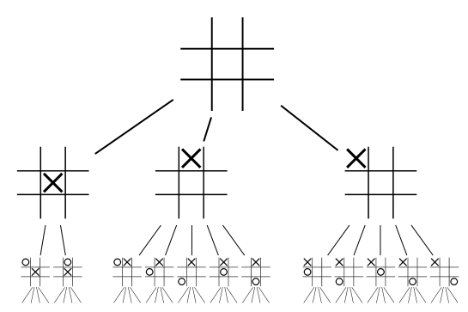
Tic-Tac-Toe
How to make an “AI” that plays Tic-Tac-Toe
Many games can be modeled as graphs or trees and reduce to a search problem
Consider the partial tree to the left
How can we search this tree to figure out how to play the game?

Slide 7
Tic-Tac-Toe
States where the game is over is called a Terminal State
A utility function determines the payout or value of a terminal state (more on this in a moment)
Each layer in the search tree is called a ply

Slide 8
Tic-Tac-Toe
Attempt 1!
Simply search the tree and find a path to the “good” terminal states
What are the good terminal states? When I have three X’s in a row!
Problem!
I’m not making every decision of which branch to follow! My opponent makes half of the choices. Need to account for this.

Slide 9
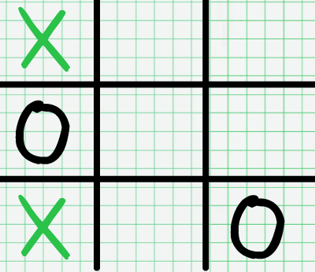
Tic-Tac-Toe
Idea! Some states are special in that I can always win if I reach that state.
The state to the left for example (I’m playing X).
I have already won because I will go in the upper right corner.
No matter what opponent does, I eventually win

Slide 10
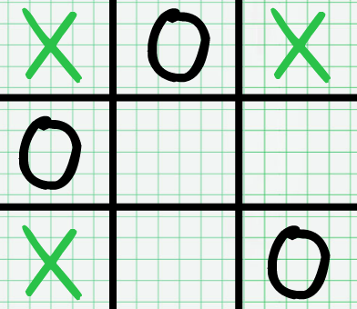
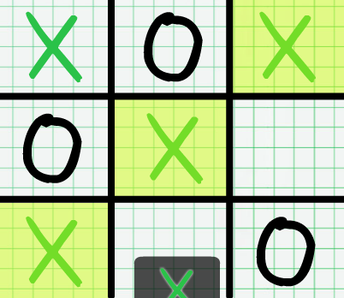
Tic-Tac-Toe
More obvious example:
Bottom state is a win state.
If I’m at the upper state (and it is my turn) then I will definitely win.
How do we extrapolate this to an algorithm?

Slide 11
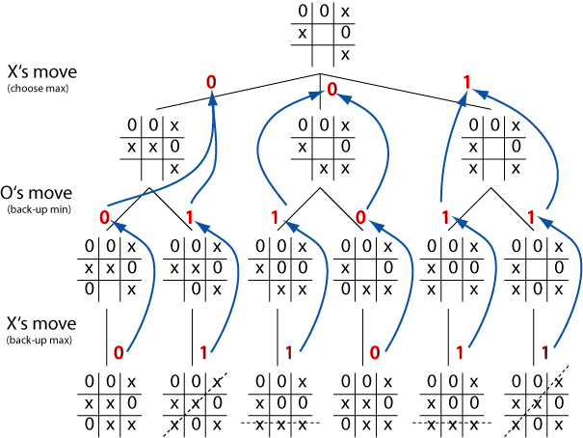
Tic-Tac-Toe: Minimax Procedure
Give leaf nodes a score
1 if AI wins
-1 if AI loses
0 if draw
Base Case:
If node on decision tree is a final state (win or lose or draw).
Return 1, -1, or 0 respectively.
So this algorithm will need to find the bottom of the tree in order to work.

Slide 12
Tic-Tac-Toe: Minimax Procedure
Give leaf nodes a score
1 if AI wins
-1 if AI loses
0 if draw
Recursive case: If internal node:
Take the minimum score if it is the human’s turn (assume they make best play possible)
Take max score if it is AI’s turn (AI takes best move possible)
AI simply follows the maximum score path through the tree

Slide 13
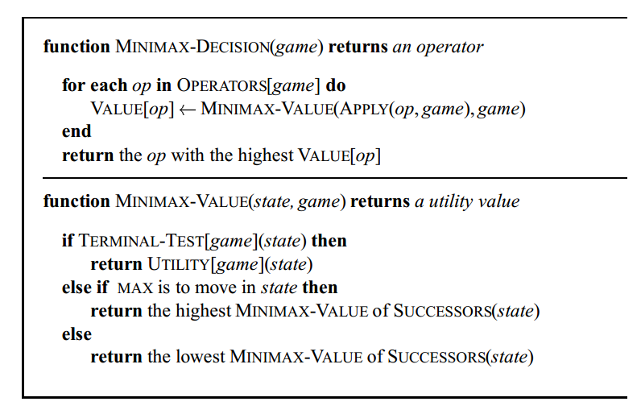
Minimax Procedure

Slide 14
Tic-Tac-Toe: Minimax Procedure
Another thing to think about:
Minimax has a major assumption:
The opponent is as knowledgeable as the computer and will ALWAYS make the best choice.
This could lead the algorithm to be pessimistic in the sense that it never tries to sneak a counter-intuitive move past it’s opponent.
Example?

Slide 15
Tic-Tac-Toe: Minimax Procedure
Corollary:
For many games (like tic-tac-toe) pure minimax will conclude that there is NO opening move that guarantees victory.
Because there is not, and if there was no one would play the AI!
Thus, it will choose optimal moves until (hopefully) the opponent messes up and leads to a node with a positive value.

Slide 16
Tic-Tac-Toe: Minimax Procedure
What about games like backgammon that have an actual score (not just a win or lose state like tic-tac-toe).
How would we alter minimax algorithm to account for that?

Slide 17
Tic-Tac-Toe: Minimax Procedure
Randomness:
Life is complicated even further if a game has random components to it.
Like backgammon
Most systems, again, employ some kind of expected value function to choose moves.
This is called the expectimax approach

Slide 18
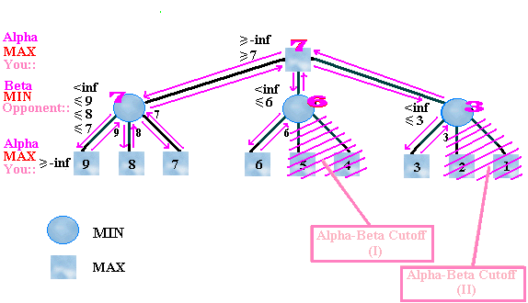
Tic-Tac-Toe: Alpha-Beta Pruning

Slide 19
Tic-Tac-Toe: Alpha-Beta Pruning
Slight optimization to the minimax procedure.
Don’t evaluate branches if they won’t affect the AI’s choice.
E.g., if I have a winning path I can take already, then don’t waste time calculating other paths that can’t exceed it
PL’s do this with Boolean expressions
A || B. If A is already evaluated to true, no need to evaluate B

Slide 20
Tic-Tac-Toe: Alpha-Beta Pruning
This is an example of a Branch-and-Bound algorithm.
This means that we bound the solution with the best already discovered path, and stop searching once this bound is surpassed.

Slide 21
Tic-Tac-Toe: Killer Heuristic
Alpha-Beta works best when best moves are considered first.
Why?
Consider we are in a state where:
On a tic tac toe board, placing an X in the corner results in a win (eventually)
On another branch of the tree, we have a VERY similar board…is it more likely another X in the corner will be a good move?

Slide 22
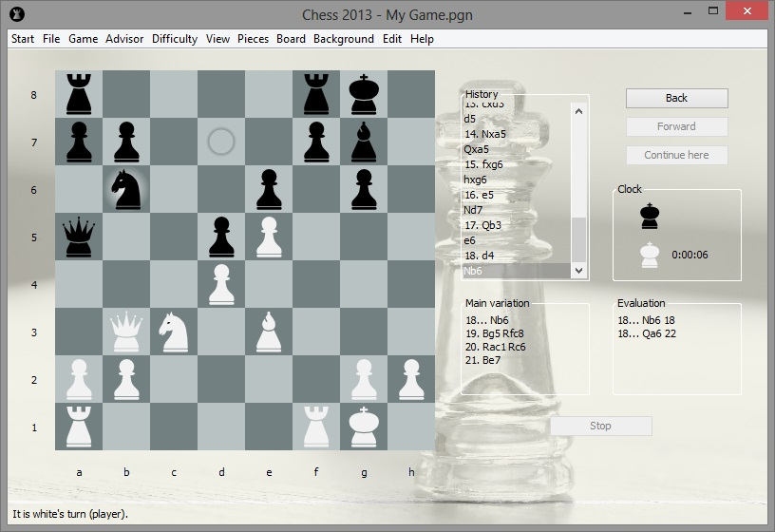
Chess: Minimax Procedure
Discussion!
What to do if the search tree is HUGE!
Chess has a very large search space
b > ~20 or so
d >= ~50 ‘ish

Slide 23
Chess
Minimax (for all but simplest search trees) is intractable.
So…we cut off search at some nodes and estimate utility using a heuristic evaluation function.
Ideally, this function is very close to the actual utility you would calculate at that node.

Slide 24
Chess
Example Chess Heuristic:
Give values to pieces:
Pawn=1, knight/bishop=3, etc.
Score board with weighted function:
w1*f1 + w2*f2 + … + wn*fn
Not the best heuristic but is a start.

Slide 25
Chess
Where to cut off the search?
Normally we do depth limited search to some depth ‘d’.
Those nodes at depth ‘d’ are estimated and we use minimax from there.
Use iterative deepening to try to get further and further down search tree.

Slide 26
Chess
In chess, we have certain states that are either dynamic or quiescent
Quiescent: State is “calm” and no important pieces will be taken soon. I.e., the next move won’t be a huge turning point in the game.
Dynamic: In one or two more turns, a big turning point could occur

Slide 27
Chess
In chess, we have certain states that are either dynamic or quiescence
This leads to the Horizon Problem, where you search to a dynamic state and the moves at depth d+1, d+2 lead to your queen getting taken!

Slide 28
Chess
Chess has some pretty standard opening and closing sequences…
We could use expert game player moves as a heuristic for the first ‘x’ moves and last ‘y’ moves.
Sounds a little like an expert system! Slightly hard-coded, but makes sense
Will improve performance

Slide 29
Best Game Playing Systems
Chess: Deep Blue
Beat world champion
Checkers:
Samuel’s learning program eventually beat developer
Othello: Programs beat the best players
Backgammon: Neural-net learning program (will see these later)
Go: Branching factor of ~360 kills most search methods. Best programs mediocre

Slide 30
Conclusions

Slide 31
AI Problems Solved by Search
Local Search
Characteristics: Path to solution doesn’t matter. Concept of neighboring states is nebulous.
Simulated Annealing, Genetic Algorithms are good techniques for these.
Classical Search
Path to solution does matter. Neighboring states is usually well-defined
BFS / DFS. Iterative deepening for large search spaces. A* with heuristics works well for many problems.
Game Playing Systems
Similar to graph search but needs to account for game elements like scores, etc.
Minimax is an excellent starting algorithm
When search space is large, need heuristics, expected value functions, etc.

Slide 32
AI Problems Solved by Search
We certainly have not studied all of the search algorithms related to AI.
However, those presented give a good introduction to the ideas and issues related to most AI problems solved with search.
At the end of the day, most interesting AI search problems boil down to finding good, relevant heuristics that enable an algorithm to shrink the size of the search space while still making good decisions / finding good solutions.

